Slide 1

AI Hackathon
Aura
NextPulse
22nd July 2025

Slide 2
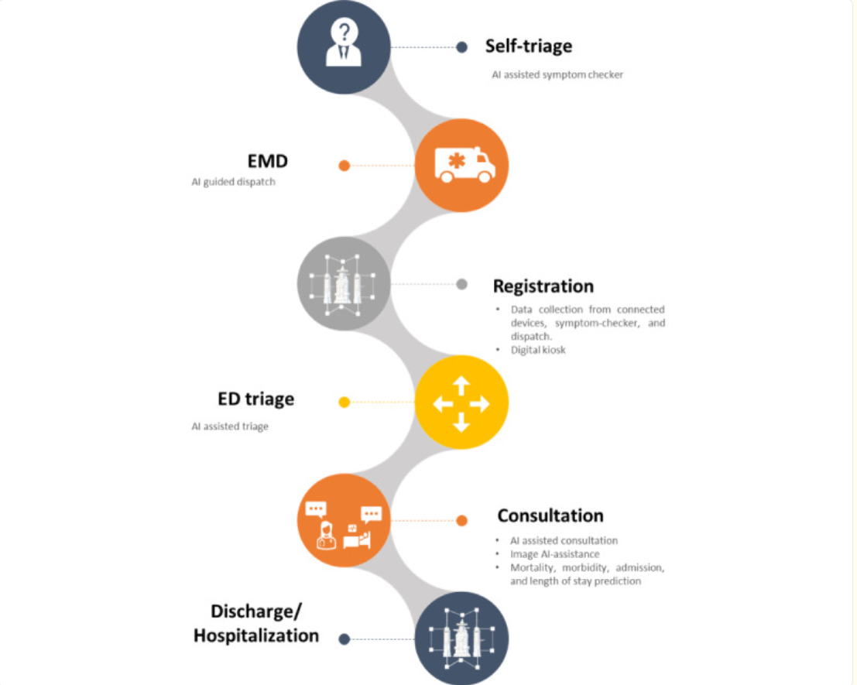
Introduction
Hackathon track / Category Operational Efficiency & Workflow Automation
Here is Why: We are addressing fragmented management of critical resources like beds, ambulances, and equipment. The focus is on reducing delays, eliminating overhead and improving coordination.
The use of AI to automate and optimize workflows (e.g. real-time resource allocation, predictive analytics for demand, intelligent routing).

Slide 3
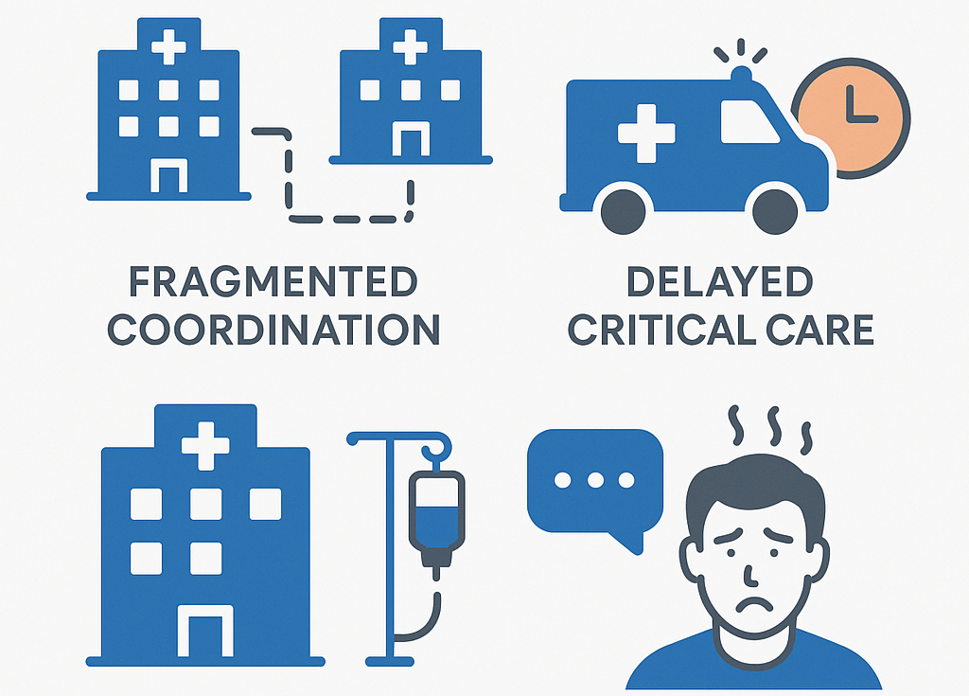
Problem Overview
Fragmented management of beds, ambulance services, and equipment—causing delays, wasted resources, and compromised patient care coordination, with a focus on how AI could help.

Slide 4
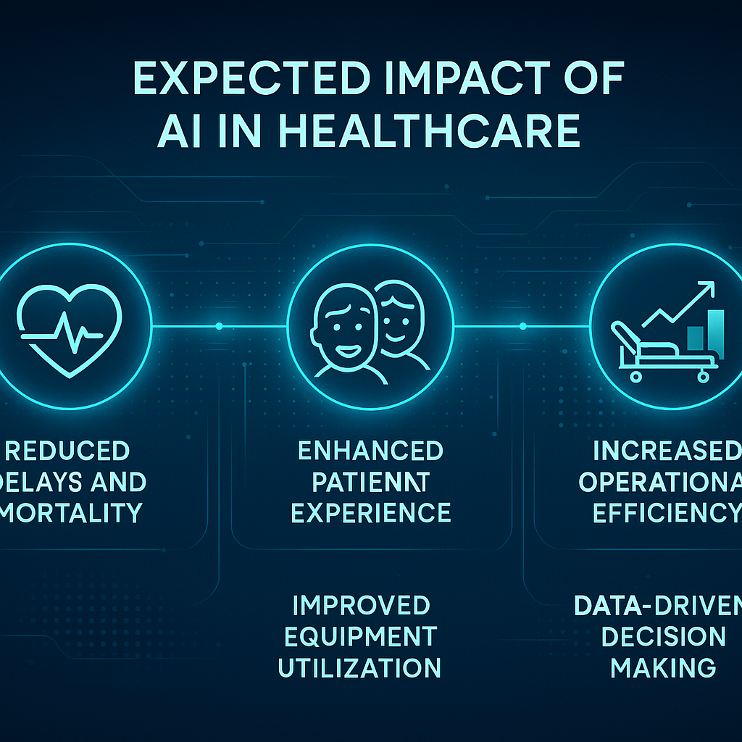
Potential Impact on Users and Business
Reduced Mortality and Morbidity: Faster critical care admissions and ambulance response during emergencies.
Increased Equipment Utilization: Minimized idle time of high-value assets like scanners, improving ROI and patient throughput.
Operational Efficiency: Automation of administrative tasks and proactive coordination reduces staff burden and delays.
Enhanced Patient Experience: Transparent, real-time communication reduces uncertainty and builds trust.
Data-Driven Decisions: AI insights enable smarter, faster decisions in high-pressure environments.

Slide 5
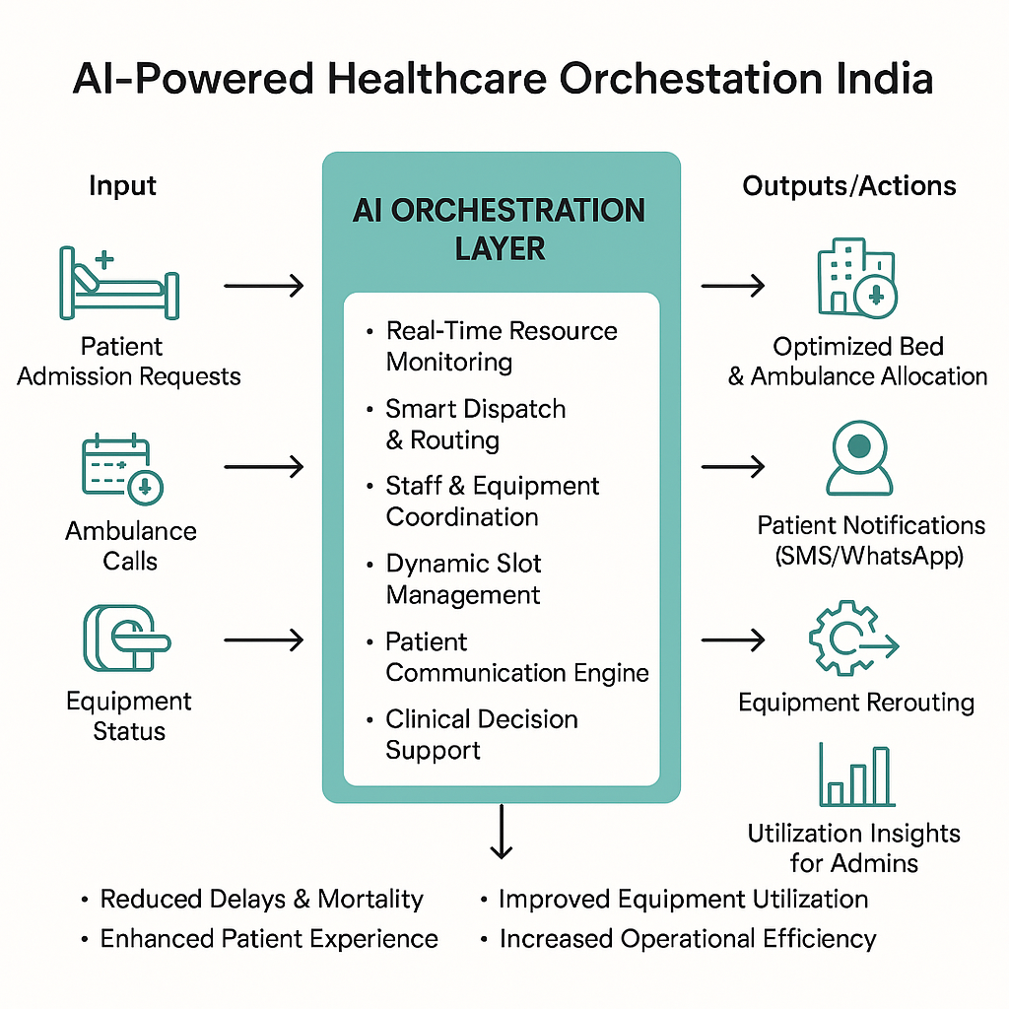
Details
How the AI Solution Works Intelligent agents, and Large Language Models (LLMs) to revolutionize healthcare resource management. It analyzes real-time data to automate triage, instantly match patient needs with available ambulances and hospital beds, and optimize routing. Predictive analytics anticipate demand, ensuring proactive resource deployment.
AI Technology Involved or developed Intelligent Agents for resource discovery, self triage, bed allocation and handover
Target Audience and Impact
Users: Emergency services, hospitals, and healthcare administrators.
Impact: Patients receive faster, more appropriate care. Healthcare providers gain optimized resource allocation, reduced delays, and improved coordination, leading to better outcomes for all.

Slide 6

Additional FAQ, Demo and Q&A
Ready for questions after the demo.

